Slide 1




A BI Capstone project on Supply Chain Analytics

Slide 2

Report Analytics & Dashboard Analytics for Stake-Holders
01
Hospiatlity Dashboard
06
02
05
04
03

Slide 3
Project Steps for Supply Chain Data Analysis
Tools Used: Excel, Tableau, Power BI, MY SQL.
Step-by-Step Workflow:
Excel Dashboard: Create an initial dashboard using provided Excel data.
SQL Integration: Load files into a SQL database under a Supply Chain data schema.
BI Tool Connection: Connect SQL database to Tableau/Power BI and create a data model with necessary joins.
Dashboard Development: Build interactive dashboards in Tableau and Power BI.
Quality Assurance (QA): Validate data by comparing database records with dashboards to ensure accuracy.
Final Presentation : Create Final Presentation and Present with PPT order
1-Group Details
2-Summary about the Project
3-KPI List
4-Excel Dashboard
5-Tableau Dashboard
6-Power BI Dashboard
7-SQL Query Image
8-Key Takeaway

Slide 4
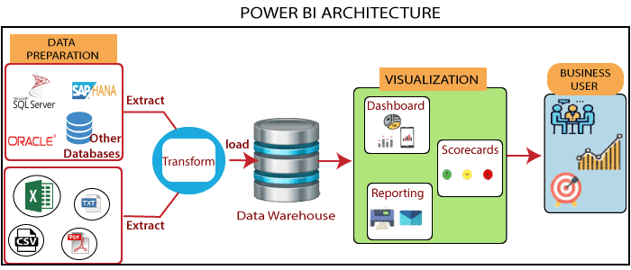

Slide 5
Project Steps for Supply Chain Data Analysis
Tools Used: Excel, Tableau, Power BI, MY SQL.
Step-by-Step Workflow:
Excel Dashboard: Create an initial dashboard using provided Excel data.
SQL Integration: Load files into a SQL database under a Supply Chain data schema.
BI Tool Connection: Connect SQL database to Tableau/Power BI and create a data model with necessary joins.
Dashboard Development: Build interactive dashboards in Tableau and Power BI.
Quality Assurance (QA): Validate data by comparing database records with dashboards to ensure accuracy.
Final Presentation : Create Final Presentation and Present with PPT order
1-Group Details
2-Summary about the Project
3-KPI List
4-Excel Dashboard
5-Tableau Dashboard
6-Power BI Dashboard
7-SQL Query Image
8-Key Takeaway

Slide 6
Report Analytics & Dashboard Analytics for Stake-Holders
Hospitality Dashboard
Total Revenue
Occupancy
Cancellation Rate
Total Booking
Utilize capacity
Trend Analysis
Weekday & Weekend Revenue and Booking
Revenue by State & hotel
Class Wise Revenue
Checked out cancel No show
Weekly trend Key trend (Revenue, Total booking, Occupancy)

Slide 7
Project Roadmap
Date | Time | Task Description
10-06-2023 | 09 AM – 10 AM | Project Kick-off Meeting
17-06-2023 | 09 AM – 10 PM | Implementation of KPI’s using Excel
24-06-2023 | 09 AM – 10 AM | Implementation of KPI’s using Tableau/SQL
01-07-2023 | 09 AM – 10 PM | Implementation of KPI’s using Power BI/SQL
08-07-2023 | 09 AM – 10 PM | Final Presentation of the Project

